Slide 1



Synthetic Aperture Radar Imager
ECE Team 11
MEMBERS:
SCOTT NICEWONGER
KEGAN STACK
JORDAN BOLDUC
OLIVIER BARBIER
JULIAN RODRIGUEZ
SPONSOR: NORTHROP GRUMMAN
ADVISORS: DR. SIMON FOO
DR. SHONDA BERNADIN
DR. RAJENDRA ARORA
INSTRUCTOR: DR. JERRIS HOOKER
DATE: 3/31/2016

Slide 2
Agenda
Overview & Theory
Applications & Design Goals
System Control
Signal Processing
Imaging Approaches
Mechanical Design
Summary
Scott Nicewonger

Slide 3
  Project Overview &
  Theory of Operation
Scott Nicewonger, Project Manager

Slide 4
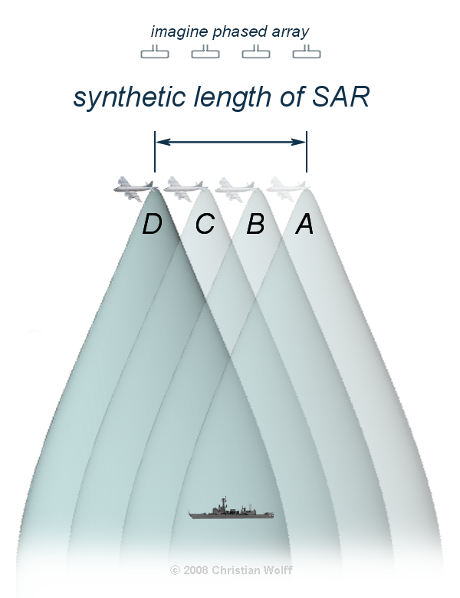
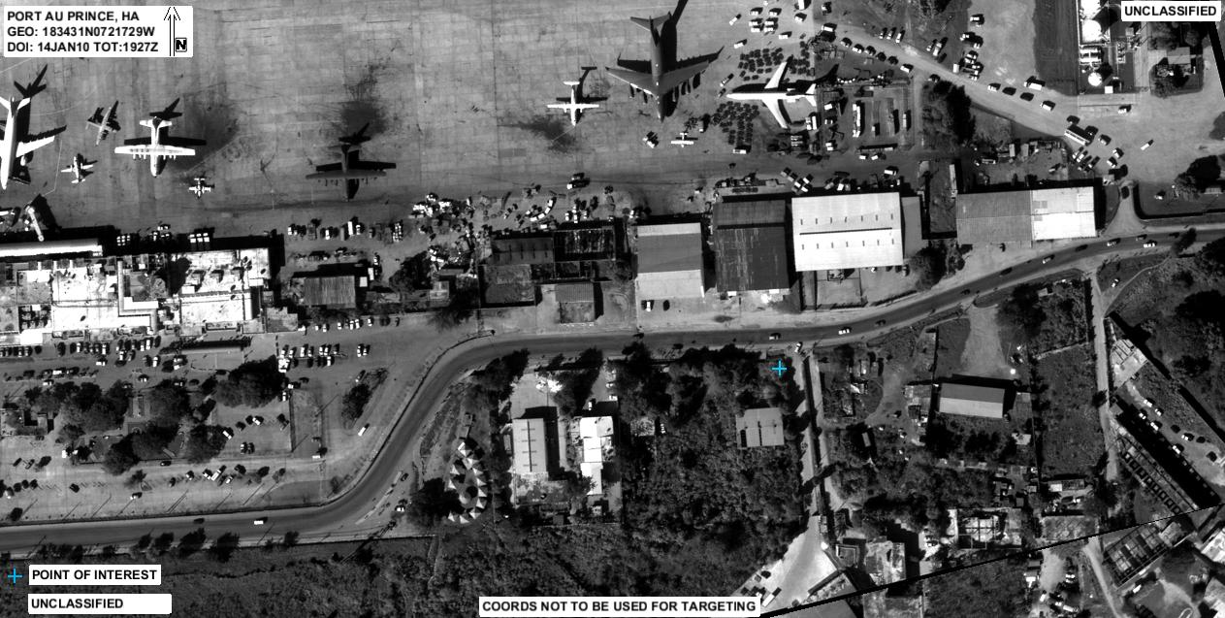
SAR Introduction
What is SAR?
Synthetic Aperture Radar: Typically, a single antenna is attached to an aircraft flying over a target zone capturing several wide-beam images, and combines them into a single, high-resolution, narrow-beam image.
Scott Nicewonger

Slide 5


Real Transmitter
TX
Synthesized Transmitter/Receiver
with Aperture Length d
TX / RX
d
Phase Center
$$≈$$
Reflective Target
RX
Real
Receiver
Scott Nicewonger

Slide 6
Stationary Scanning
1-D Side View
Front View
TX
PC 1
RX₁
TX
RX
PC 2
RX
Phase Centers are formed at the midpoint between each transmitter/receiver pair
Pulsing a linear array of receivers enables a scan of the target area without any moving parts
Imager consists of linear arrays in X and Y axes to scan the entire scene
RX
PC 3
RX₂
RX
PC 4
TX
RX
RX
RX
RX
RX
RX
RX
RX
TX
RX
RX
RX₃
RX
RX
TX
RX₄
Scott Nicewonger

Slide 7


Phase Slope
θ
nd sin(θ_{n})
3d sin(θ_{n})
16 Phase Centers
16 θ_{n} ‘s that map to 16 unique regions in the scene
For each θn , a 16-point complex basis function is generated
Received data is convolved (DFT) with basis functions to map energy amplitude VS frequency
2d sin(θ_{n})
d sin(θ_{n})
d
R
$$≈$$
Downrange
Scene
θ_{n}
R $≈$R cos θ
d = 3λ
Scott Nicewonger

Slide 8
Design Overview
Objective
  Develop a static, multi-antenna Synthetic Aperture Radar (SAR) Imager
Specifications
Low resolution proof of concept prototype
10 GHz operating frequency
20 feet range
40” x 40” downrange scene
Safety
RF Exposure Safety Guidelines
  ANSI/IEEE C95.1-1992
  FCC 47 C.F.R. 1.1307(b), 1.1310, 2.1091, 2.1093
Limit for human exposure: 1 mW/cm²
SAR Peak Transmit: 0.0076 mW/cm²
Scott Nicewonger

Slide 9
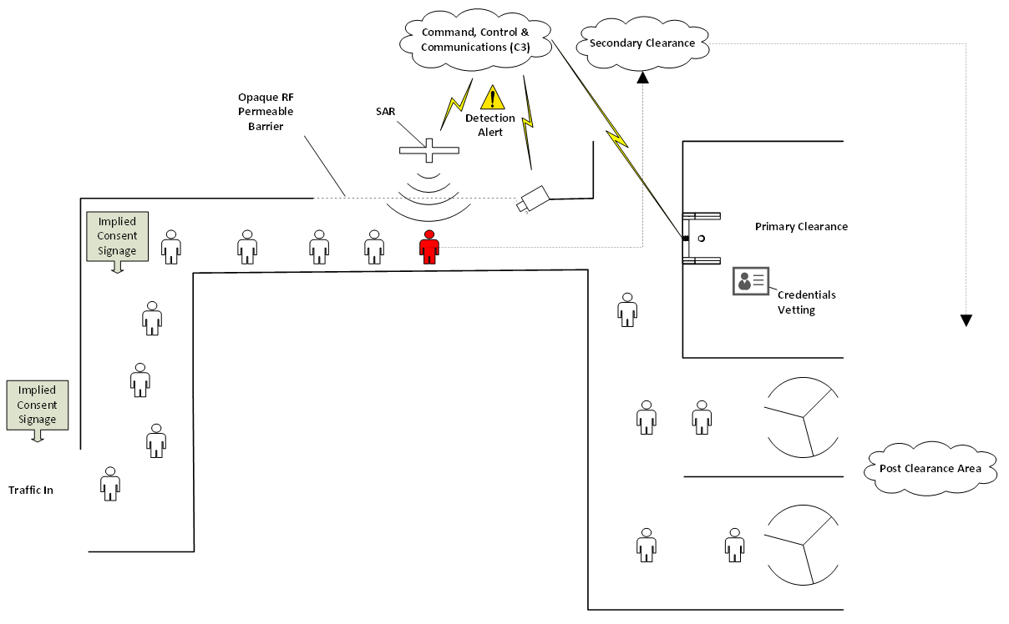

Applications
Concealed Weapon Detection at an Access Control Point
Security industry: protection of high risk areas
Supplemental measure for layered security environments
Primary measure for certain environments
Unique Capabilities
Ranged scanning $⇒$ no apparatus to step into
Discreet placement
Vett the queue before individuals get to Access Control
Scott Nicewonger

Slide 10
Prototype Design Goals
Electrical Engineering
Identify radar reflector at 20 feet
FPGA signal processing for real-time & standalone functionality
MATLAB signal processing for testing & future development
Mechanical Engineering
Mobility
Structural stability
Less than 80 lbs weight
Horn adjustment fidelity & stability
Scott Nicewonger

Slide 11
Scott Nicewonger

Slide 12
System Control & Signal Processing
Jordan Bolduc
Jordan Bolduc

Slide 13
Xilinx NEXYS 3 FPGA Board
FPGA Controls:
Switching Between Transmit Mode & Receive Mode
Data Processing and Logic
  ADC to Read Voltages from IQ Demodulator
  Read & Write to Memory
Image Processing
  16 Columns – Dedicated Display
Jordan Bolduc

Slide 14
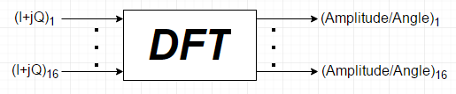
Signal Processing Approach
Reflected signal comes in as two separate components
Amplitude and angle of arrival information is necessary for energy at the scene
A Discrete Fourier Transform (DFT) is necessary
Phase Information From Target
Spatial
Information
To Display
Jordan Bolduc
Notes:
You can probably put a little more on this slide

Slide 15
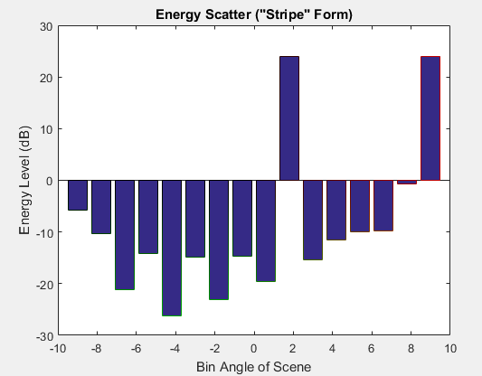
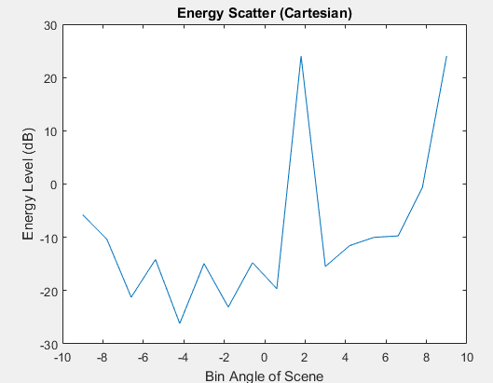
Imaging Approach: Dedicated VGA
Direct FPGA – Driven Display
  Standalone Capabilities
  Dedicated Display
  Field Ready
  Closer to Real Time
Jordan Bolduc
Notes:
What do you mean by “field ready”

Slide 16
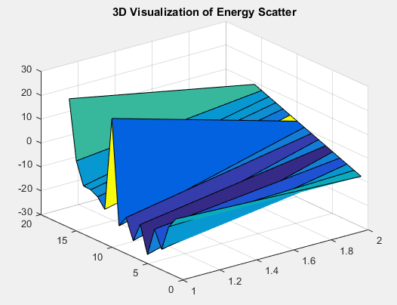
Imaging Approach: MATLAB
MATLAB
  Testing
  Data Visualization
  Industry Demonstrations
  Future Development
Jordan Bolduc
Notes:
What do you mean by “field ready”

Slide 17
Mechanical Design
Kegan Stack

Slide 18
Mechanical Design Goals
Structure
Horn Holders & component housing
Modular
Mobile
Lightweight
  Less than 80lbs
Stable
  Movement causes artificial phase shifts
Horn Holders
  2 Degrees of freedom
  Lightweight
  Won’t damage antennas
Components housing
  Lightweight
  RF shielded
  Modular
Kegan Stack

Slide 19
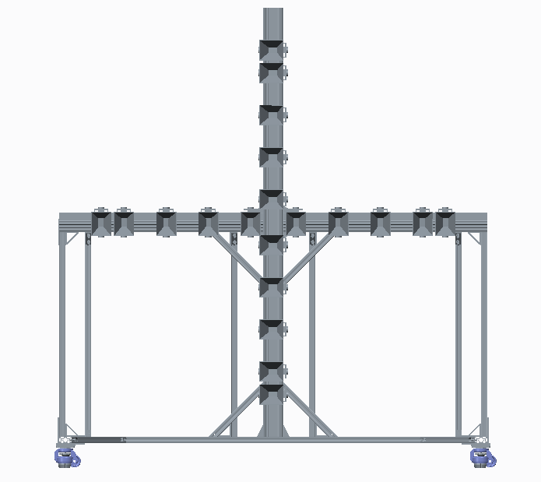
FRAME V 4.0
66”
Status: Assembled
Weight: 55lbs
Cost $700
What’s left?
  Optimizing for stability & stiffness
    Additional sections, gussets & leveling feet
    Loctite & torque all fasteners
30”
7.09”
3.54”
Leveling castors
70”
Kegan Stack

Slide 20

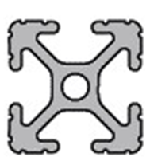
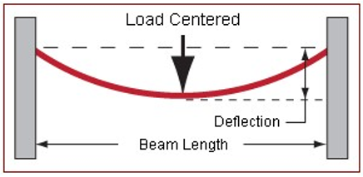
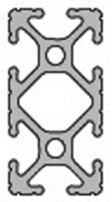
Structure Force Analysis
Performed a force analysis to check deflection and find improvements
Application of test force in center of beam with rigid endpoints
Force set to 20 lbs to account for the vertical beam and half of component box
Length set to 62”
Original 1010
  Deflection of 0.0623(in)
New 1020
  Deflection 0.0098 (in)
  6X less deflection
Kegan Stack

Slide 21
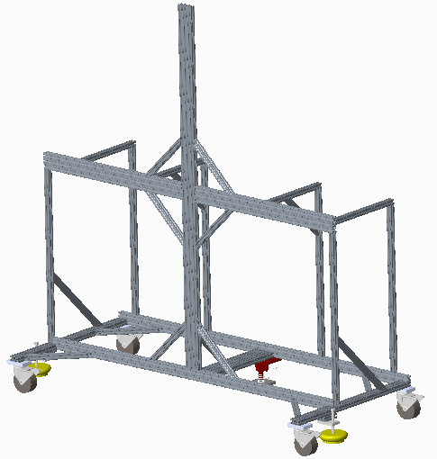
Structure Revision: V 4.1
Addition to current structure
Switch to rubber 4” casters
  No leveling caster presents alignment dilemma
  Solved with foot floor lock (red) and adjustable vibration feet (yellow)
Additional gussets to stiffen the structure
Base pieces changed to 1020
1030 piece added to middle of base to unify base
Gussets
Changed to 1020 series
1030 series
Kegan Stack

Slide 22
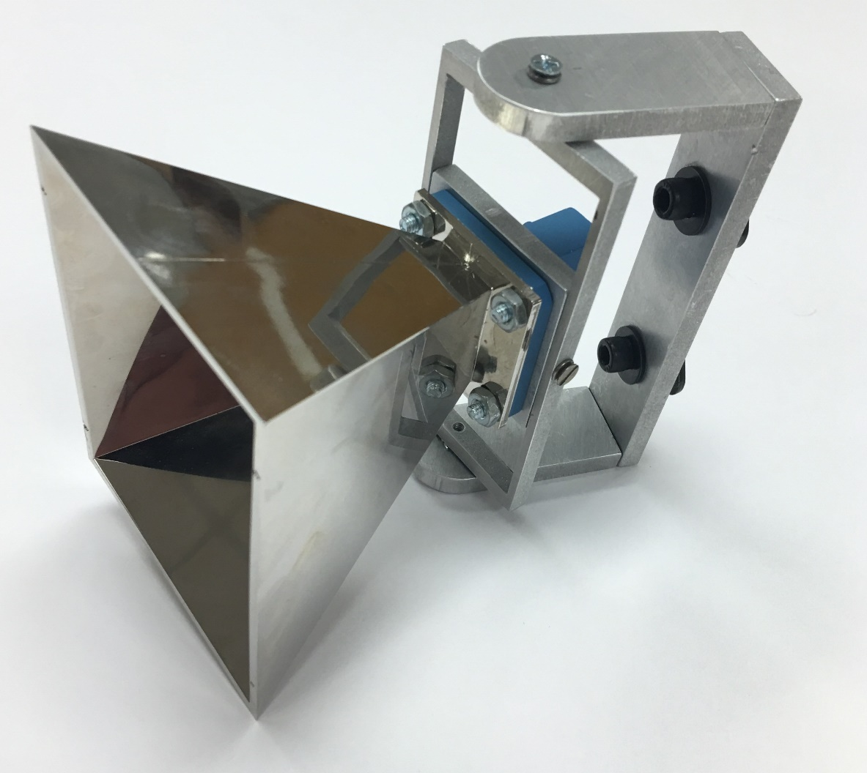
Horn Holders
2.5”
Status: Complete
  Optimized fastening method with thumb screws
  Additional tolerance added for star washer
Weight: 1.5lb
Cost: $15 per horn holder
1”
4.64”
Kegan Stack
Notes:
This is where you could elaborate on how we met the design goals set in slide 2

Slide 23
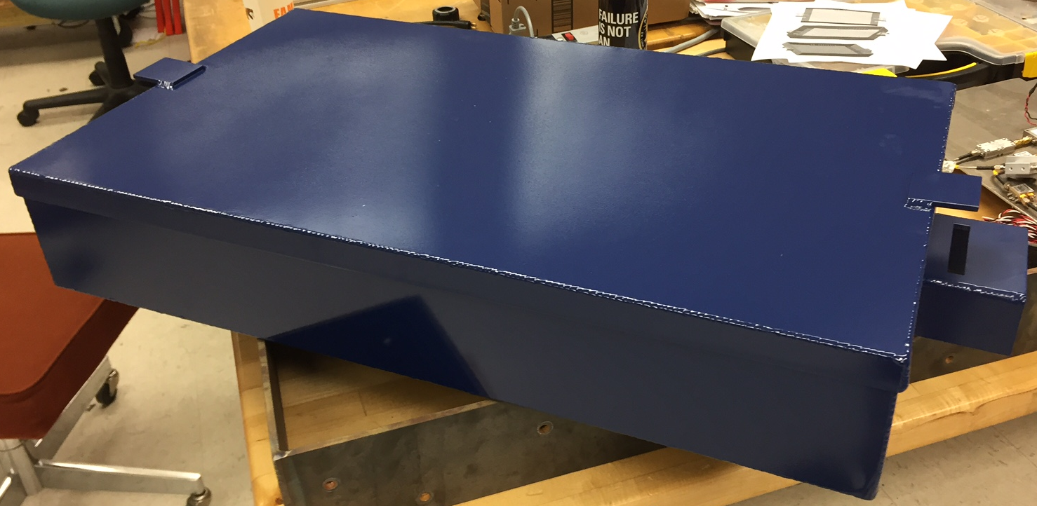
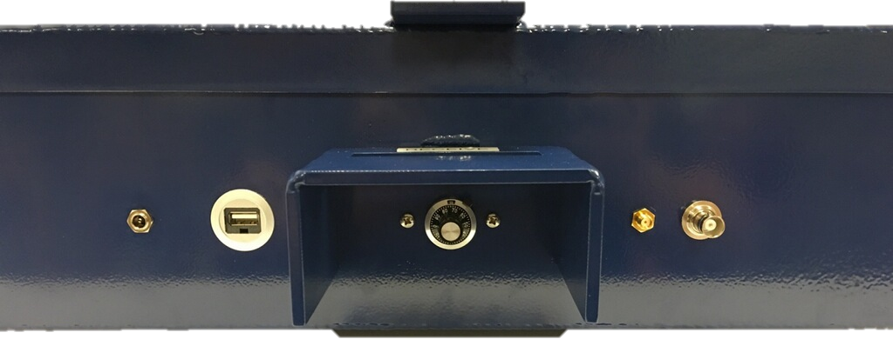
Component Housing
Assembled
  Water jetted
  Welded
  Powder Coated
Machine Shop Error
  Redesign component layout
Install: Securable Latches
Weight: 12.9 lbs w/o components
Kegan Stack
Notes:
The design philosophy for the box was to first and foremost be accessible for the electrical engineers to conduct their testing as well as being as sealed from the outside environment as much as possible to protect from EMI, in which I will speak about in further detail later. Every input and output to and from the box goes through a panel mounted connection to not only enclose the box but also to make connections as simple as possible. The image above is a view which hides the walls to better show each connector installed into the box. Aluminum 6061 was selected due to its high electrical conductivity, strong weldability, and of course cost. The weight is approximately (12.9 lbs) compared to last year’s weight of (roughly 40lbs) down 67.75%. The latches on the side ensure the enclosure is properly shut when needed, and have the option to install padlocks if need be.

Slide 24
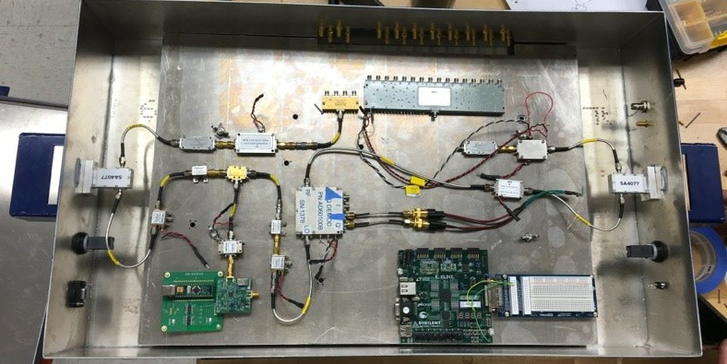
Installation – Electrical Components
Drop-in tray
  Removable
  Modular
  Vibration-dampening standoffs
Kegan Stack
Notes:
**Might want to briefly mention RF shielding since you mentioned it in slide 2. Also, we can take a new picture with it wired up now. –Scott **
With the new dimensions for the box, some recalculations had to be made to determine the new thermal analysis. After changing the surface areas and thicknesses within the MatLAB code I created for thermal analysis, again using a Thermal Resistance Network, the total heat dissipation possible actually went up. Previously, the box would have only been able to dissipate approximately (155.37 W) compared to now with a value of (178.08 W). That is up by (14.6%). With this new heat dissipation, this translates to a factor of safety of (5.12).

Slide 25
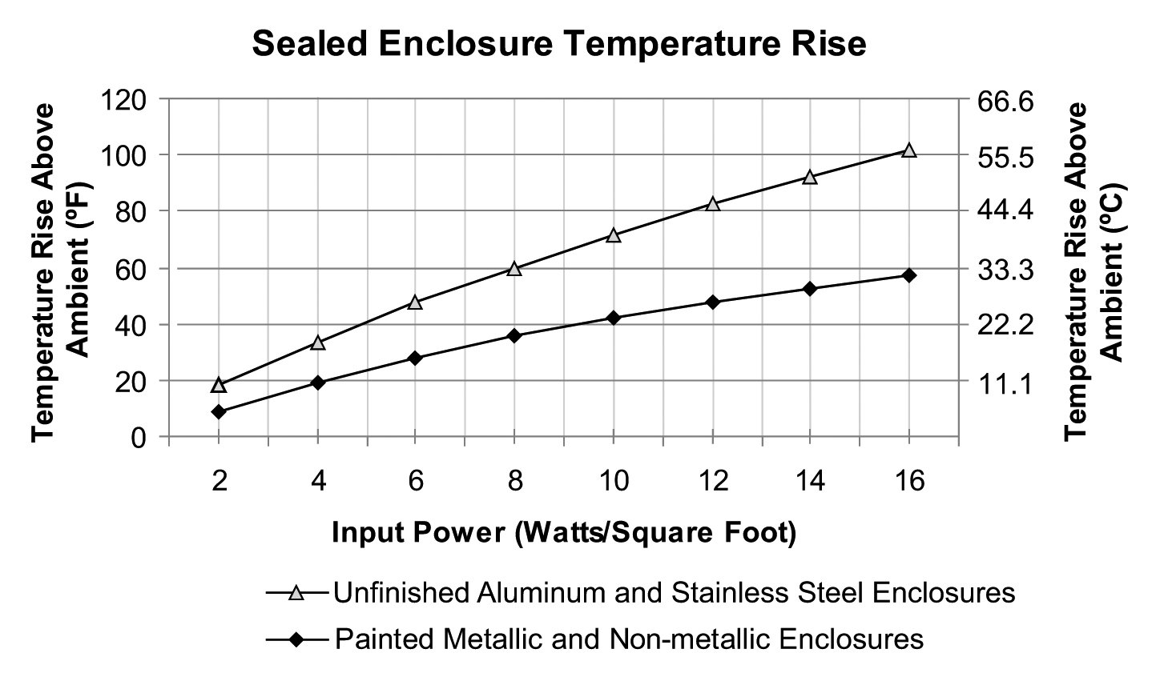
Thermal Analysis
Previous temperature rise: 16.65° C (before paint)
Current temperature rise: 9.5° C (after paint)
  Radiant heat transfer efficiency
42% Enclosure temperature decrease
Highest enclosure temperature: 30.5° C
Component maximum operating temperature: 50° C
Kegan Stack
Notes:
Explain chart from Pentair’s (thermal and fluid mgmt. comp) technical document. With the surface area about 10.5ft^2 and total power supplied to components - is 34.8 W. The heat flux is around 3.32. Using the graph one can determine the temperature rise. State previous enclosure before paint, 16.65 increase = 37.65 C, assuming room temperature of 21 C. After paint, only 9.5 C increase = 30.5 C. This is due to an aluminum’s unfinished surface less efficient radiant heat transfer. This translates to 42% decrease on enclosure temperature. Since the most sensitive component’s failure temp is at 50 C, then it is deemed safe by a large amount (19.5 C)

Slide 26
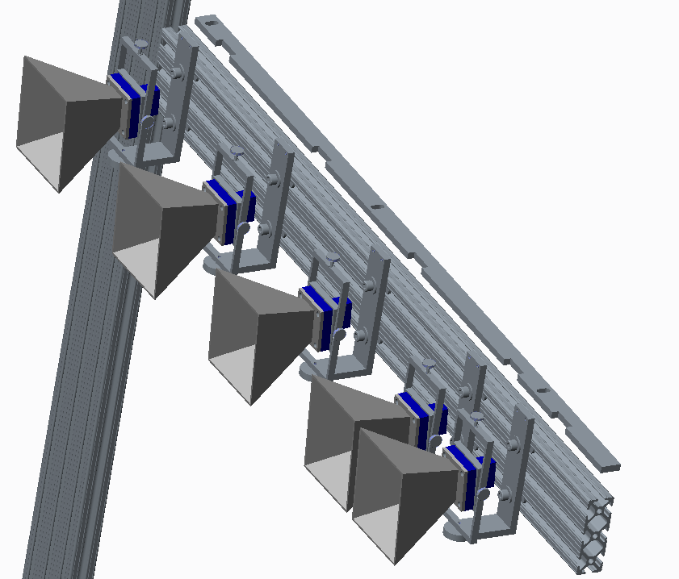
Horn Spacing - Jig
Simplest way to ensure exact horn spacing
Cut in house with the water jet
  Accurate to within 0.003”
Repeatable: Measures from the intersection of the frame – out
Jig
Kegan Stack

Slide 27
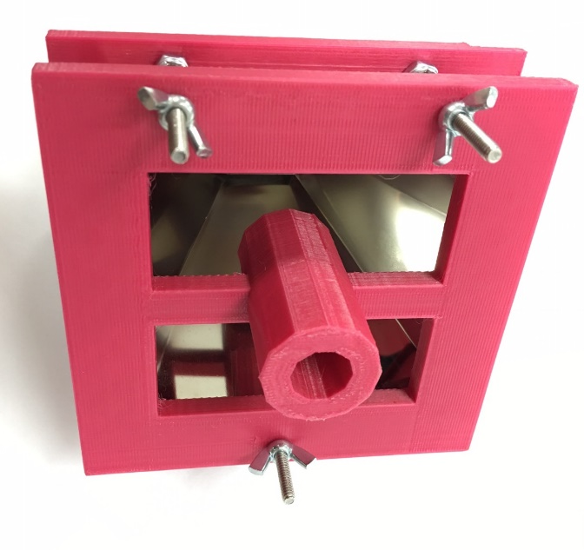
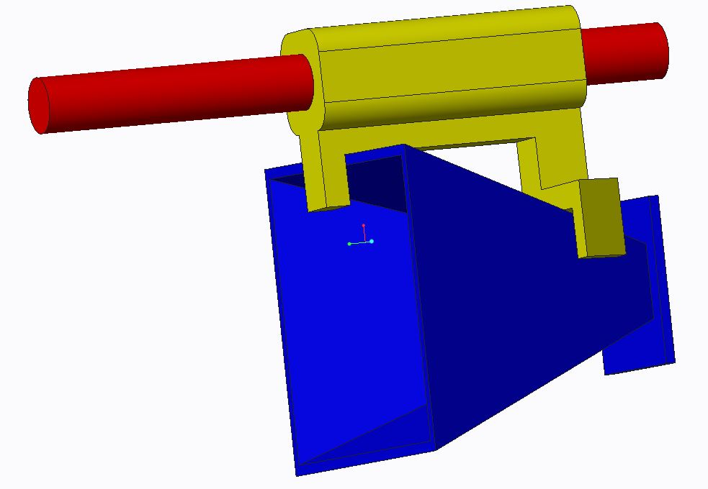
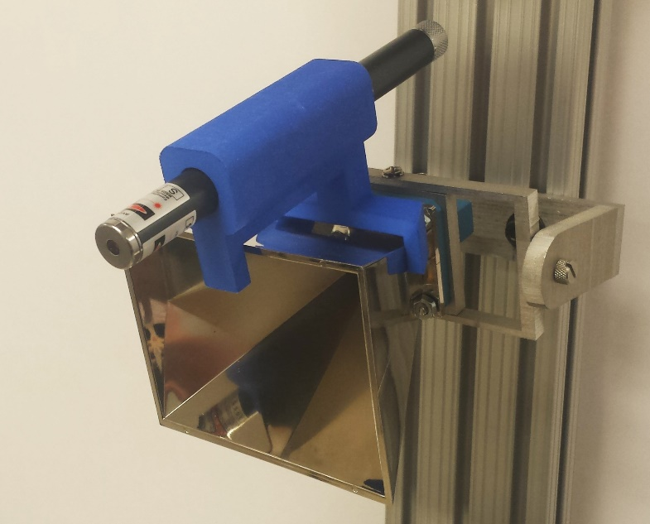
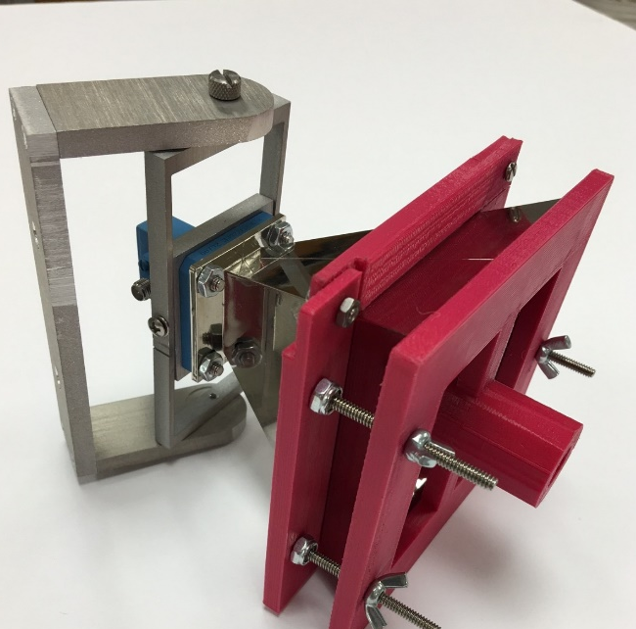
Calibration Alignment
Kegan Stack
Notes:
Pics of both designs would show we went through a prototyping and evaluation phase in our designs

Slide 28
Summary
Task | Completion Status
System Control Logic | 100%
MATLAB Signal Processing Logic | 100%
FPGA Signal Processing Logic | 60%
MATLAB Imaging Logic | 100%
FPGA Imaging Logic | 75%
Antenna Array Structure | 100%
Electronic Component Installation & Housing | 95%
Full-scale RF Range Testing | Pending
Kegan Stack

Slide 29
Questions?
Presenters:
Scott Nicewonger (EE), Project Manager, RF Engineer
linkedin.com/in/ScottNicewonger
swn10@my.fsu.edu
Jordan Bolduc (EE), Signal Processing Engineer
jpb12c@my.fsu.edu
Kegan Stack (ME), Lead Mechanical Engineer
kts11d@my.fsu.edu

Slide 31
Calibration Code
Why create calibration code?
  Corrects for the Far Field Assumption
  Going off and targeting at an angle
  Isolates the peak energy level
Two Methods
  Main Goal: Boresight Calibration
  Contingency Plan: Logical Indexing

Slide 32
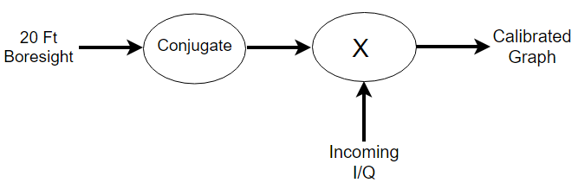
Boresight Calibration
Take raw data measurement 20 feet away at boresight
Multiply by complex conjugate of these numbers
Calibrate all the rest of incoming data with this conjugate to calibrate
Eliminates most of the far field assumption up to about 15 degrees from boresight
Not perfect, but works for the scope

Slide 33
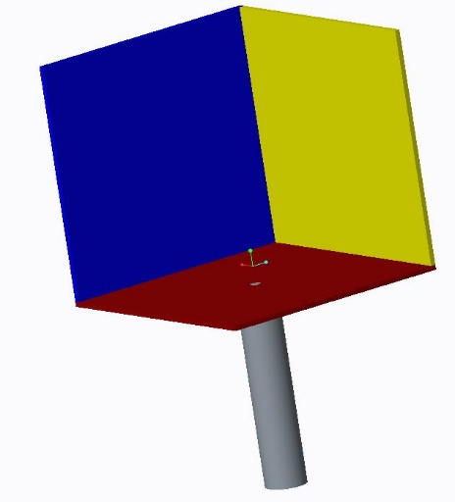
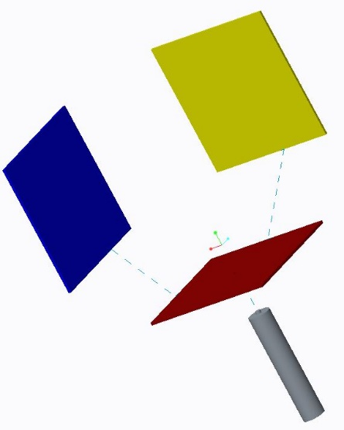
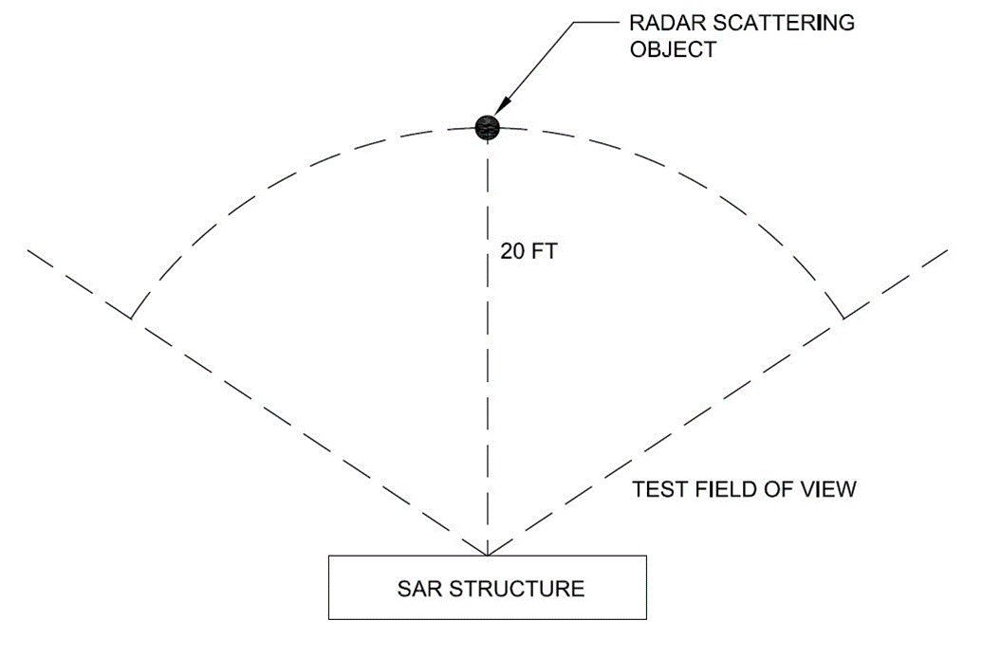
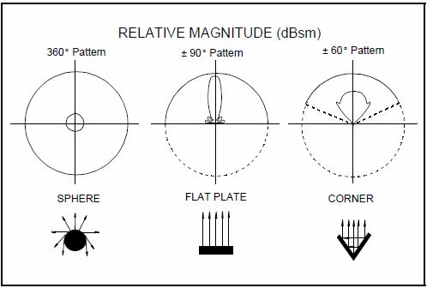
Radar Reflectors
Purpose is to create backscatter
  Reflects transmitted RF back to receiving horns
Transmit
Receive
KEGAN STACK

Slide 34
Matrix Logical Indexing
Advantages
Can eliminate the noise floor
Sets all data to zero if below certain energy level
Should only show stripe in the bar graph
Can also be used for display purposes along with boresight calibration
Disadvantages
Not very accurate
Does not account for and take away large reflections that are detected
Must know energy expected energy level for detection

Slide 35
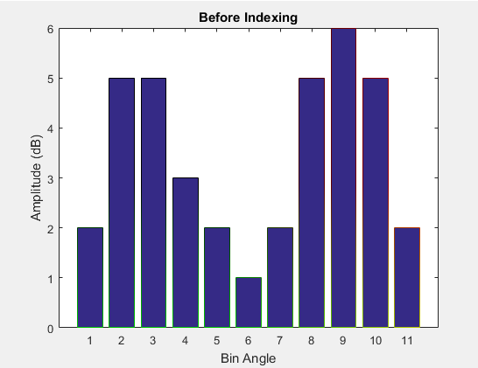
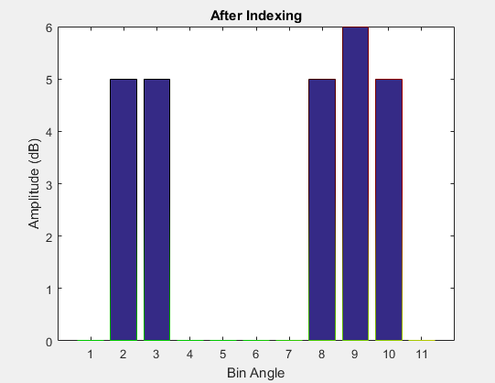
Matrix Logical Indexing
>> Data = [2 5 5 3 2 1 2 5 6 5 2];
>> Data(~(Data > 4)) = 0
Data =
0 5 5 0 0 0 0 5 6 5 0

Slide 36
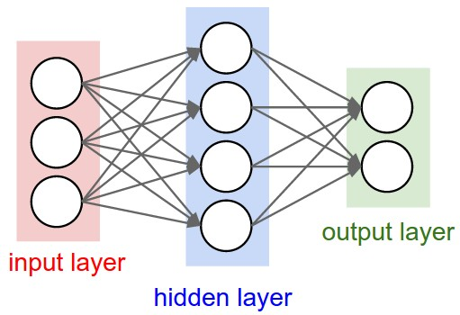
Neural Network
Still open to implementation
Time dependent
Can be worked on in between teams
3rd Generation Goal

Slide 37
MATLAB GUI & Diagram
Will implement the laptop as part of the signal path
FPGA and MATLAB “talking” with each other
Creating custom Graphical User Interface (GUI)
Expected Challenges:
  Converting 12 bit binary word to decimal
  Accuracy after conversion
  Calibration calculations
JORDAN BOLDUC

Slide 38
2015-2016 Budget
Items yet to be purchased:
Secure case for electrical components
Storage for testing equipment
RF Panel setup
Replacing faulty equipment
Renting testing equipment
JOSH DENNIS

Slide 39
Overall Budget (2014-2016)
JOSH DENNIS

